Slide 1




Senior Project Presentation
Detecting Political Bias in Media using
Predictive Modeling
Presented by: Sachin Narain Srivastava, Aditi Mishra, Kaushiki Sharma

Slide 2


Project Abstract
Overview: This project aims to identify political bias in media articles by analyzing sentiment associated with political entities. Leveraging machine learning techniques, the model assigns bias labels to news content, potentially helping users understand political leanings within media sources.
Keywords: Bias Detection, Sentiment Analysis, Predictive Modeling, Political Bias, Machine Learning.

Slide 3


Project Goals and Objectives
Goal:
To build a predictive model that can classify news articles based on political bias—Right, Left, or Neutral.
Objectives:
Collect and preprocess relevant news article data.
Implement a machine learning pipeline to analyze sentiment and assign bias.
Evaluate model accuracy and optimize for improved predictions.

Slide 4
Methodology and Approach
1
Data Collection: Using a dataset containing URLs, political sentiment scores, and additional metadata.
3
Modeling:
Train a Naive Bayes classifier, test its effectiveness, and explore alternative models (Logistic Regression, SVM).
Evaluation Metrics: Accuracy, Precision, Recall, and Cross-Validation Scores.
Data Preprocessing:
Text cleaning, tokenization, and vectorization (TF-IDF).
Feature engineering with a bias scoring system based on democrat and republican sentiment.
2
4

Slide 5

Expected Outcomes and Impact
Outcomes:
A model capable of categorizing news articles as Left, Neutral, or Right based on their content.
A web application interface that allows users to check the predicted bias of specific articles.
Impact:
Increased awareness of political bias within media content.
A valuable tool for researchers, journalists, and consumers interested in media bias analysis.

Slide 6

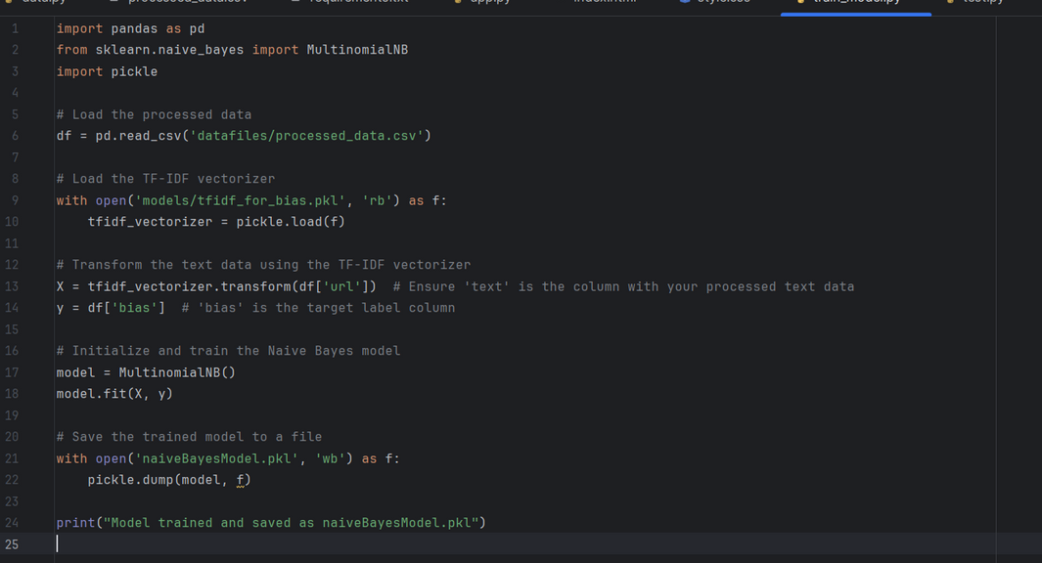
Key Project Deliverables
Data Pipeline: A complete preprocessing script (data.py) that loads, cleans, and transforms text data.
Machine Learning Model: A trained Naive Bayes model saved as naiveBayesModel.pkl.
Web Application: A Flask-based web interface for users to interact with the bias prediction model.
Documentation: Detailed project report covering methodology, model analysis, and future improvements.

Slide 7
Next Steps
Refinement:
Experiment with alternative models to improve prediction accuracy.
Balance the dataset or apply resampling techniques to address any class imbalance.
Expansion:
Explore the integration of additional features, such as named entity recognition for in-depth political context.
Implement real-time news updates and bias scoring for dynamic analysis.
Deployment:
Host the application on a cloud platform for public access.

Slide 8
Conclusion
Summary: This project presents a valuable approach for identifying political bias in media articles, using machine learning to enhance transparency in news consumption.
Future Vision: By refining the model and expanding the dataset, this tool has the potential to become an accessible solution for identifying bias across various media sources.
Acknowledgments: Special thanks to mentors, peers, and resources that contributed to this project.

Slide 9



Documentation

Slide 10
Thank
You

